Slide 1
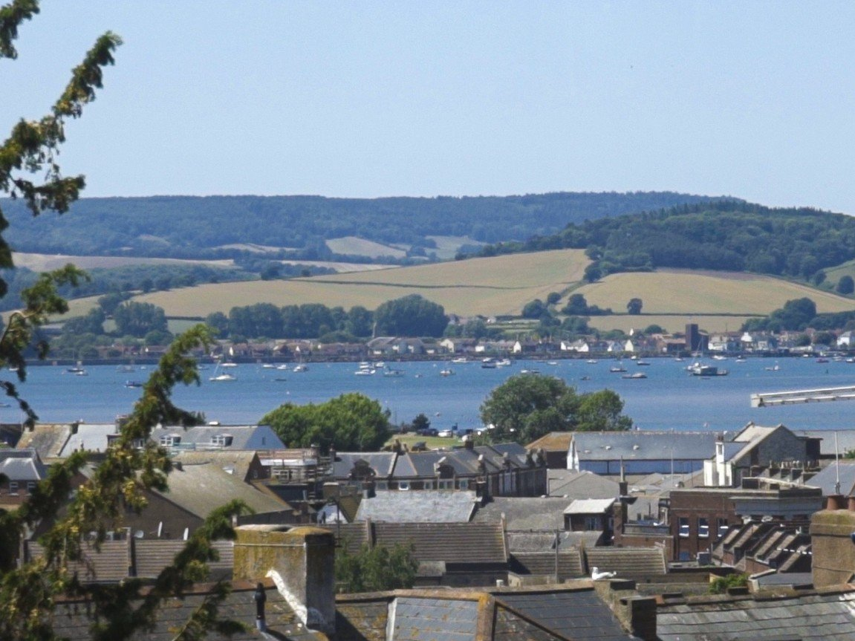
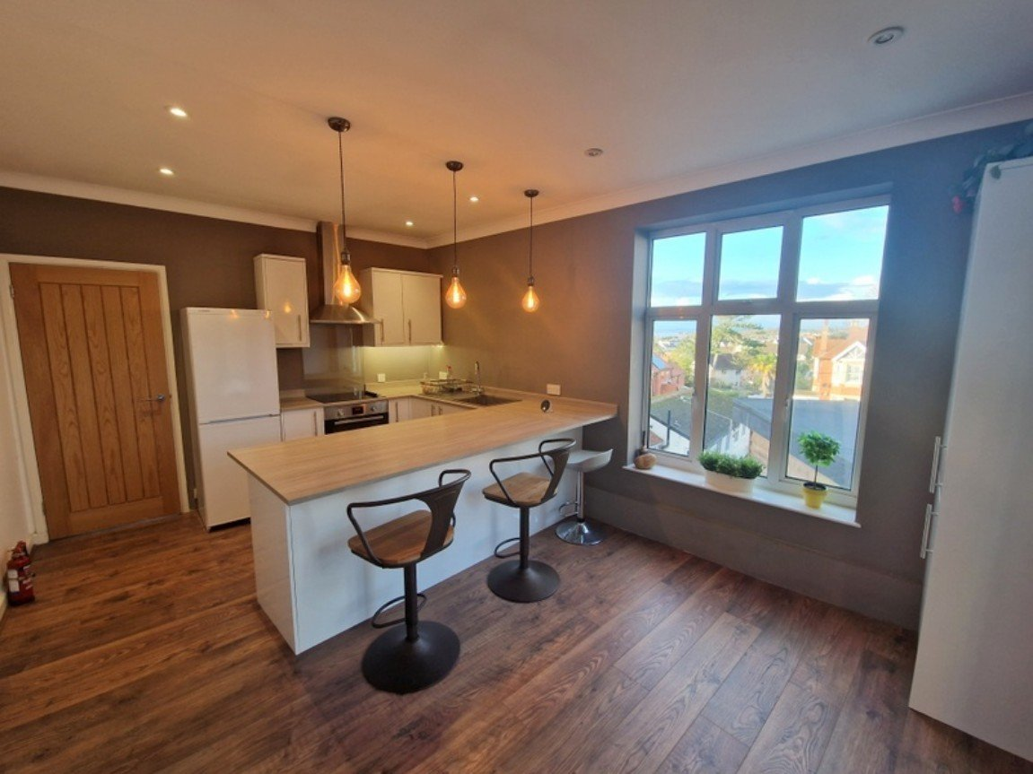
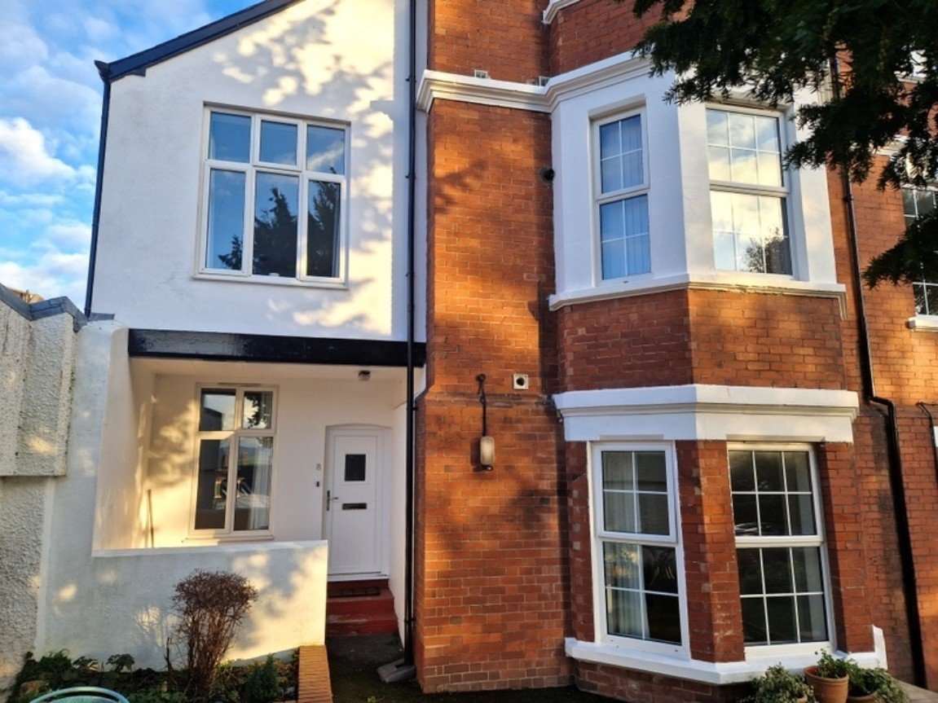
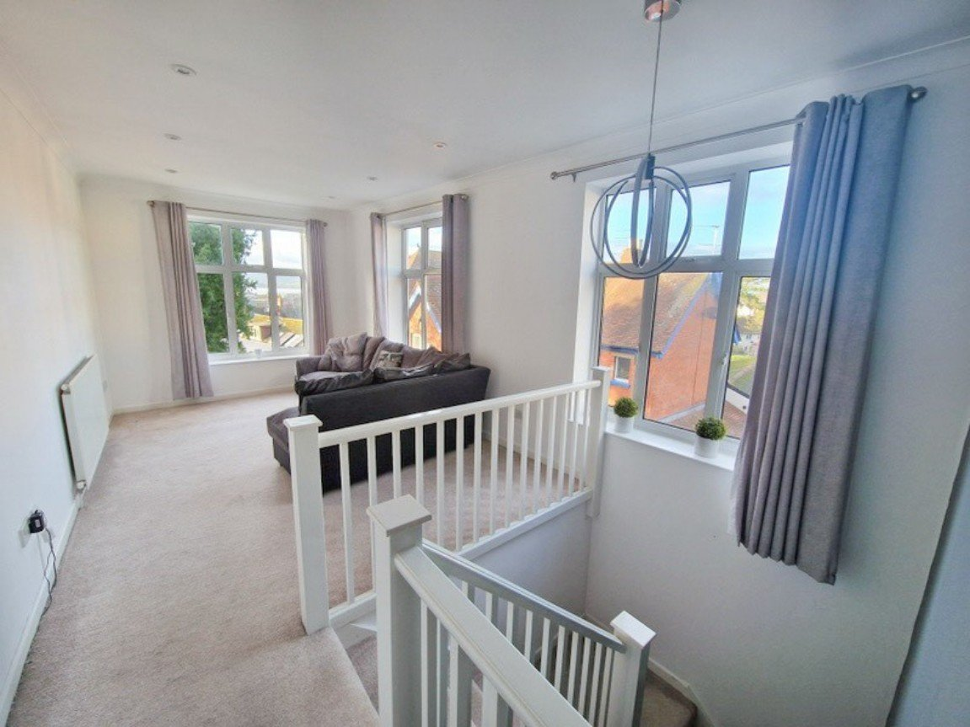
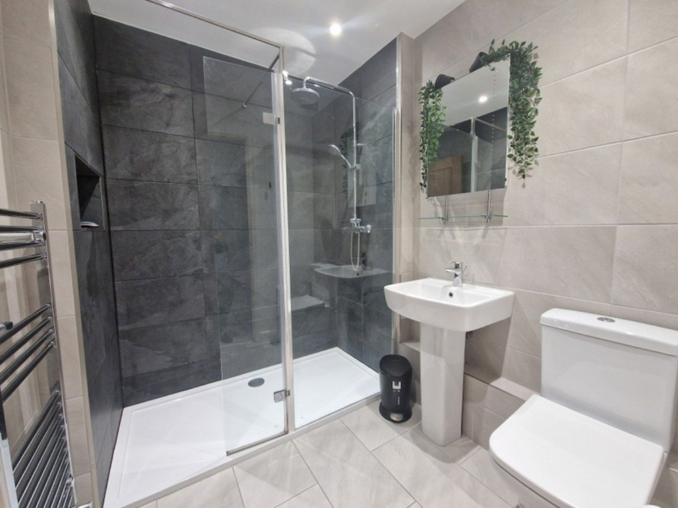
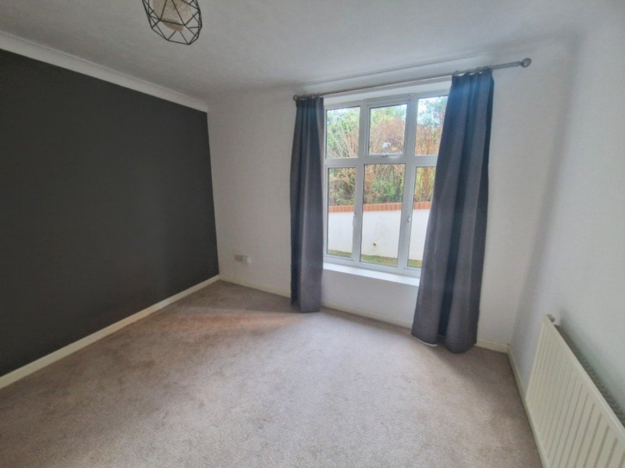
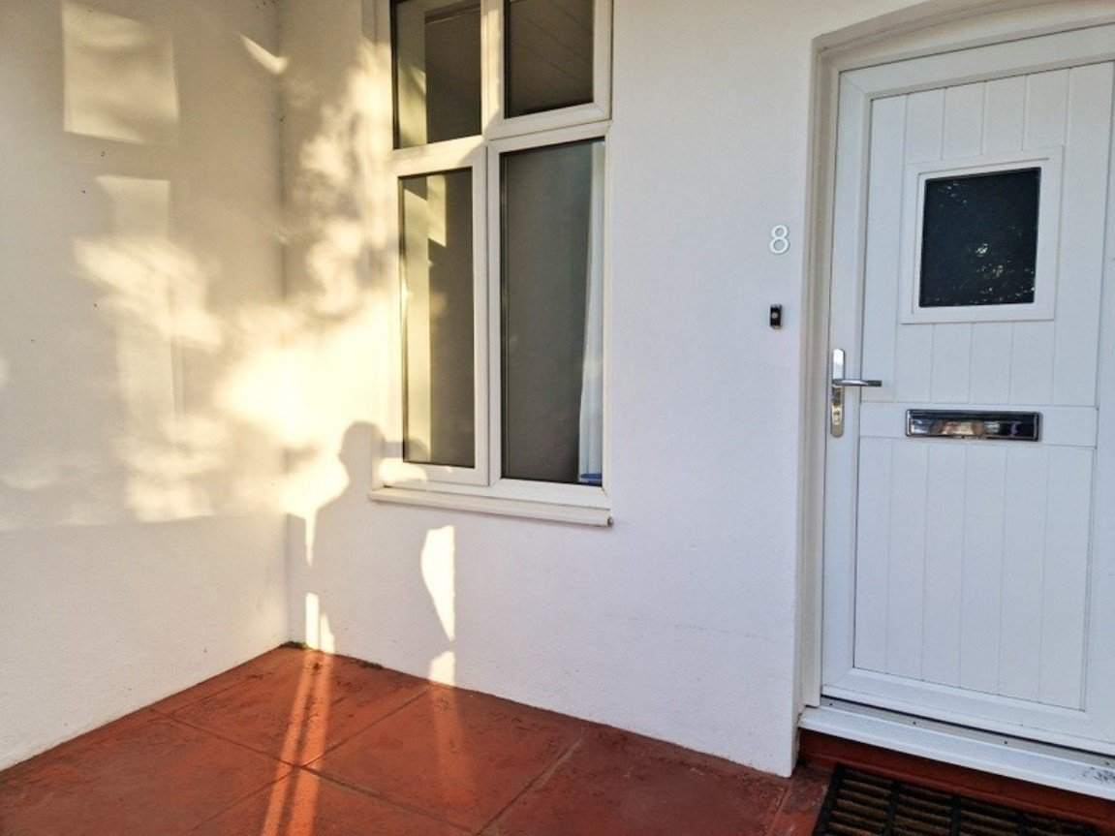
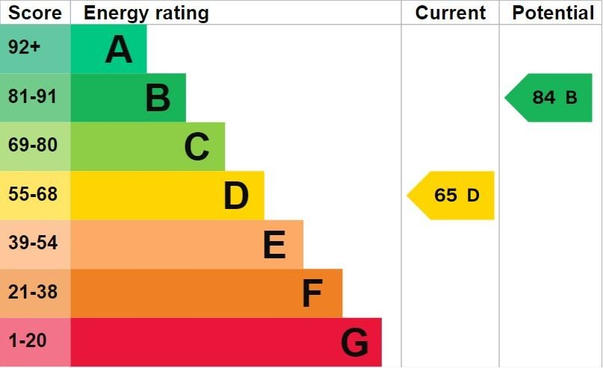
www.pennys.net
Flat 8 Montpellier Court, Montpellier Road, Exmouth, EX8 1JP
PRICE £235,000
TENURE Share of Freehold
An Individual Cottage Style Maisonette Forming Part Of A Select Development With Stunning Estuary Views And Located Close To The Town Centre
Dual Aspect Lounge/Dining Room With Super Views •
Stylish Modern Kitchen/Breakfast Room •
Two Bedrooms • Modern Shower Room/WC • Allocated Parking •
Private Patio Area • Gas Central Heating • Double Glazing •
No Onward Chain •
Pennys Estate Agents Limited for themselves and for the vendor of this property whose agents they are give notice that:- (1) These particulars do not constitute any part of an offer or a contract. (2) All statements contained in these particulars are made without responsibility on the part of Pennys Estate Agents Limited. (3) None of the statements contained in these particulars are to be relied upon as a statement or representation of fact. (4) Any intending purchaser must satisfy himself/herself by inspection or otherwise as to the correctness of each of the statements contained in these particulars. (5) The vendor does not make or give and neither do Pennys Estate Agents Limited nor any person in their employment has any authority to make or give any representation or warranty whatever in relation to this property.
PENNYS ESTATE AGENTS
2 Rolle House, Rolle Street, Exmouth, Devon, EX8 2SN
Tel: 01395 264111 EMail: help@pennys.net

Slide 2
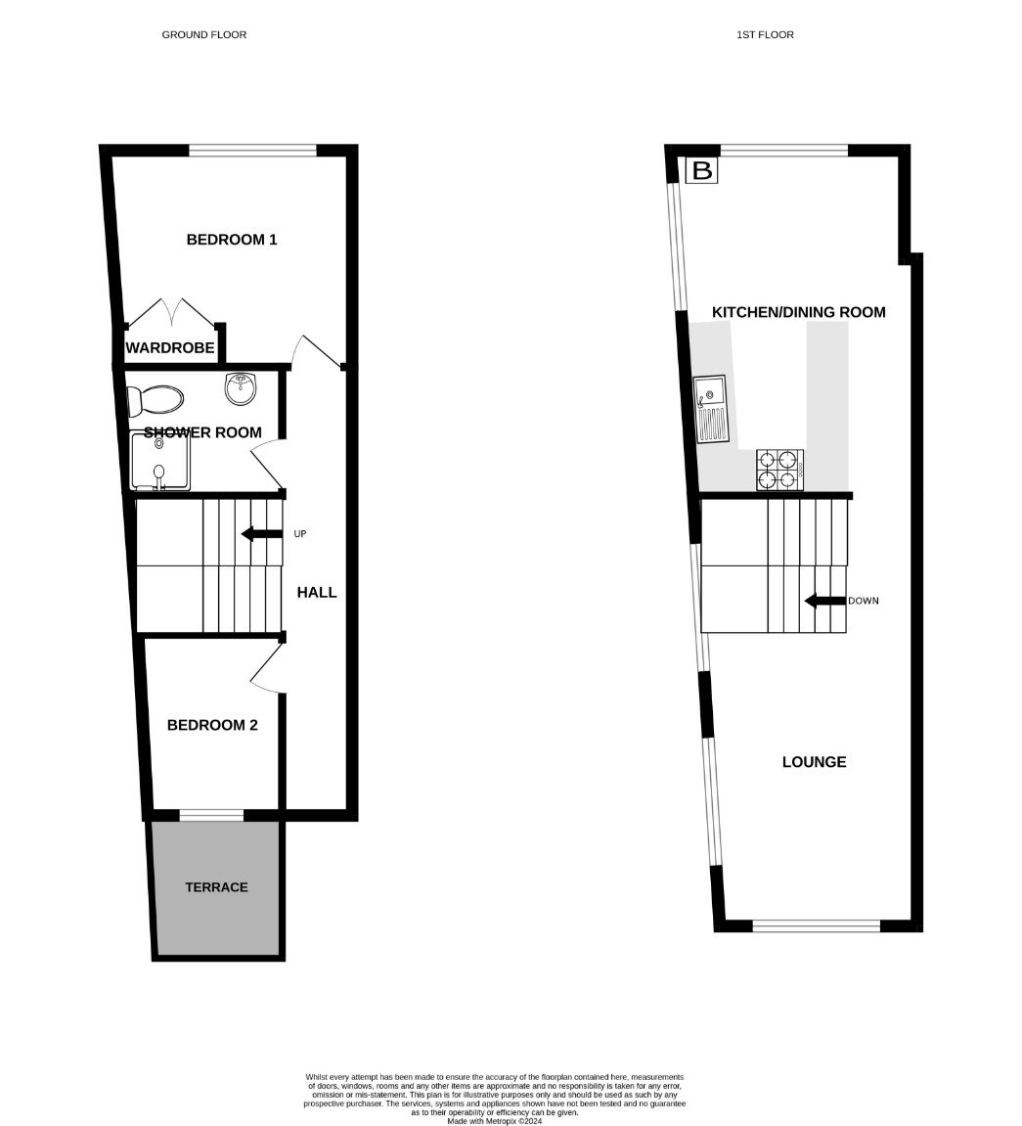
Flat 8 Montpellier Court, Montpellier Road, Exmouth, EX8 1JP
THE ACCOMMODATION COMPRISES: Private entrance with uPVC front door to: RECEPTION HALL: Radiator; stairs to first floor landing; electric consumer unit. BEDROOM ONE: 3.45m x 3.15m (11'4" x 10'4") Double glazed window to rear aspect; radiator; built-in wardrobe. BEDROOM TWO: 2.57m x 1.91m (8'5" x 6'3") Double glazed window to front aspect; radiator; fitted cupboard. SHOWER ROOM/WC: 2.18m x 1.83m (7'2" x 6'0") Stylishly refitted with double width shower cubicle with fixed and detachable shower head hoses; shower splash screen; pedestal wash hand basin with mirror over with integrated light; WC with push button flush; chrome heated towel rail; tiled floor; attractive part tiled walls; recess ceiling LED spotlighting; extractor fan. FIRST FLOOR LOUNGE/DINING ROOM: 6.1m x 3.2m (20'0" x 10'6") A bright dual aspect room with three sets of double glazed windows gaining stunning views to the estuary and coastline beyond; television point; radiator; access to roof space. KITCHEN/BREAKFAST ROOM: 5m x 3.4m (16'5" x 11'2") A spacious modern room fitted with a range of worktop surfaces extended to provide a large breakfast bar area with down lighters over; cupboards, drawer units, integrated dishwasher and further appliance space beneath worktops; inset single drainer sink unit with mixer tap; four ring electric hob with glass splash back; built-in oven beneath and stainless steel extractor hood over; recess ceiling LED spotlighting; double glazed windows to side and rear aspects with estuary views; radiator; space for freestanding fridge freezer; upright cupboard housing gas boiler. OUTSIDE: The property benefits from ONE ALLOCATED PARKING SPACE and a storage shed. There is also visitors parking. TENURE AND OUTGOINGS: We understand that the property is held on a remainder of a 125 year lease from 1995 and also benefits from a 1/25th share of the freehold. The service charge is £110.00 per calendar month and a ground rent of £50.00 per annum. Management agents are Eton Terry Clark of Exmouth.
FLOOR PLAN:

